Slide 1
6.852: Distributed Algorithms Fall, 2015
Lecture 8

Slide 2
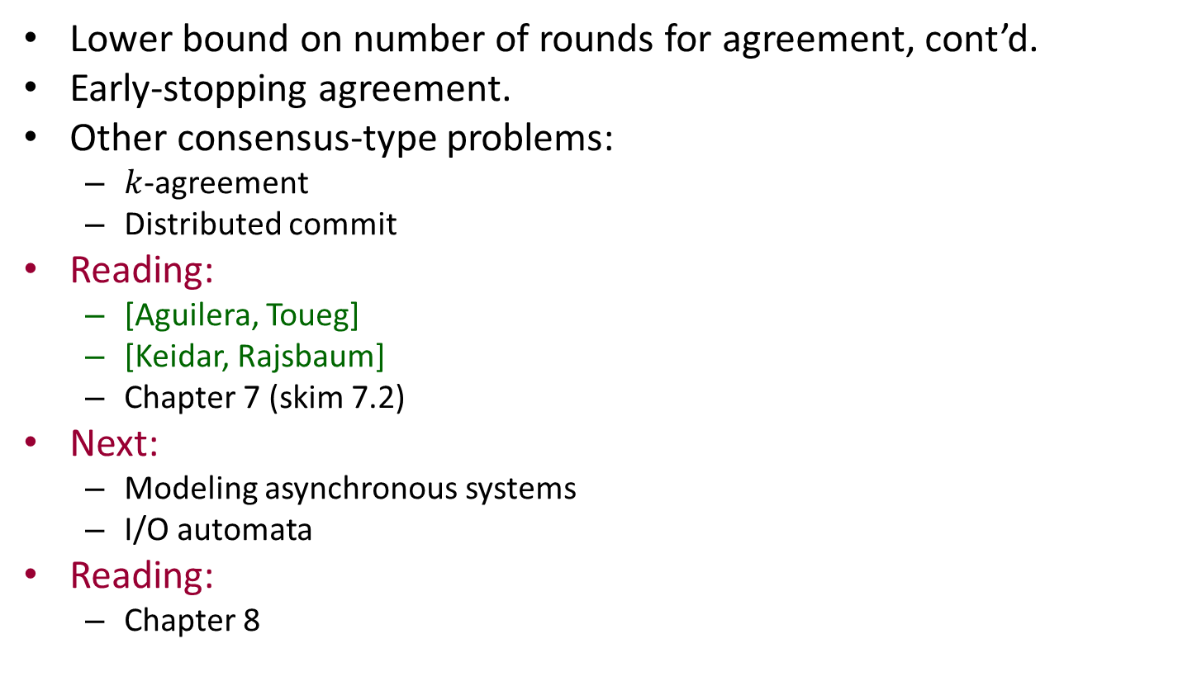
Today’s plan
Lower bound on number of rounds for agreement, cont’d.
Early-stopping agreement.
Other consensus-type problems:
$k$-agreement
Distributed commit
Reading:
[Aguilera, Toueg]
[Keidar, Rajsbaum]
Chapter 7 (skim 7.2)
Next:
Modeling asynchronous systems
I/O automata
Reading:
Chapter 8

Slide 3
Lower bound on number of rounds for agreement
Notes:
Now something quite different.

Slide 4
Lower bound on number of rounds
f+1 rounds are needed in the worst-case, for either Byzantine agreement or just stopping agreement.
Assume an f-round stopping agreement algorithm A tolerating f faults, get a contradiction.
Assume:
n-node complete graph.
Decisions at end of round f.
V = {0,1}
All-to-all communication at every round.

Slide 5
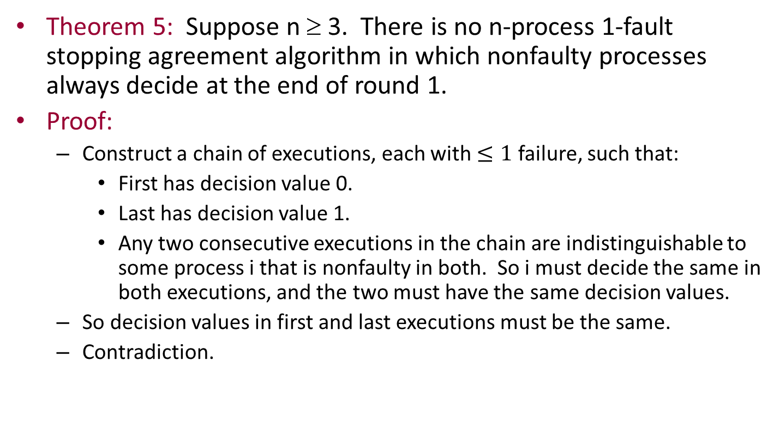
Special case: f = 1
Theorem 5: Suppose n ≥ 3. There is no n-process 1-fault stopping agreement algorithm in which nonfaulty processes always decide at the end of round 1.
Proof:
Construct a chain of executions, each with $≤1$ failure, such that:
First has decision value 0.
Last has decision value 1.
Any two consecutive executions in the chain are indistinguishable to some process i that is nonfaulty in both. So i must decide the same in both executions, and the two must have the same decision values.
So decision values in first and last executions must be the same.
Contradiction.
Notes:
Similar to the chain we saw for the 2-generals problem.

Slide 6

Special case: f = 2
Theorem 6: Suppose n ≥ 4. There is no n-process 2-fault stopping agreement algorithm in which nonfaulty processes always decide at the end of round 2.
Proof:
Construct a chain of executions, each with $≤2$ failures.
Start with α₀: All processes have input 0, no failures
Work toward α_{n}, all 1’s, no failures.
Each consecutive pair is indistinguishable to some nonfaulty process.
Use intermediate executions α_{i} in which:
Processes 1,…,i have initial value 1.
Processes i+1,…,n have initial value 0.
No failures.
0
0
0
0

Slide 7
Special case: f = 2
WLOG, show how to connect α₀ and α₁, that is, change p1’s initial value from 0 to 1.
Start with α₀, work toward killing p1 at the beginning, by removing messages.
Change p1’s initial value.
Then replace messages, working back up to α₁.
Start by removing p1’s round 2 messages, one by one.
Can’t continue by removing p1’s round 1 messages, because consecutive executions would not look the same to anyone.
E.g., removing 1 → 2 at round 1 allows p2 to tell everyone about the failure, at round 2.
0
So, use many steps of the chain to remove the round 1 message from p1 to p2.
In these steps, both p1 and p2 are faulty.
0
0
0
Notes:
Other steps are essentially the same.
We are now allowed 2 failures.

Slide 8
Removing p1’s round 1 messages
Start with execution where p1 sends to everyone at round 1, and to no one at round 2. Only p1 is faulty.
Remove round 1 message 1 → 2:
p2 starts out nonfaulty, so sends all its round 2 messages.
Now fail p2, and remove its round 2 messages, one by one, until we reach an execution where 1 → 2 at round 1, but p2 sends no round 2 messages.
Now remove the round 1 message 1 → 2.
Executions look the same to everyone but p1 and p2.
Replace round 2 messages from p2, one by one, until p2 is no longer faulty.
Repeat to remove p1’s round 1 messages to p3, p4,…
After removing all of p1’s round 1 messages, change p1’s initial value from 0 to 1.

Slide 9
General case: Any f
Theorem 7: Suppose n ≥ f + 2. There is no n-process f-fault stopping agreement algorithm in which nonfaulty processes always decide at the end of round f.
Proof:
Same ideas, longer chain.
Must fail f processes in some executions in the chain, in order to remove all the required messages, at all rounds.
Construction in book, LTTR.
Alternative proof [Aguilera, Toueg]:
Uses ideas from [Fischer, Lynch, Paterson] impossibility of consensus (which you will see later).
They assume strong validity, but their proof works for our weaker validity condition also.
Notes:
FLP proof coming up soon…when we study asynchronous fault-tolerant computing.
Recall the validity conditions for stropping failures:
Strong validity: every decision is someone’s initial value.
Weak validity: if everyone starts with the same value v then v is the only allowed decision.
Actually these are equivalent if we have only two values 0 and 1 in V.
This can be a bit confusing because earlier today we had a still-weaker validity condition, for WBA. But now we aren’t talking about that.

Slide 10
[Aguilera,Toueg] lower bound proof
By contradiction. Assume A solves stopping agreement for f failures and everyone decides after exactly f rounds.
Consider only executions in which at most one process fails during each round.
Recall: Failure at a round allows a process to send any subset of the messages, or to send all but halt before changing state.
Regard vector of initial values as a 0-round execution.
Definitions (adapted from [FLP]): α, an execution that completes some finite number (possibly 0) of rounds, is:
0-valent, if 0 is the only decision that can occur in any execution (of the kind we consider) that extends α.
1-valent, if 1 is the only decision that can occur in…
Univalent, if α is either 0-valent or 1-valent (essentially decided).
Bivalent, if both decisions occur in some extensions (undecided).
Notes:
One failure per round is what happens in our earlier proof also.
Since we are considering a limited number of failures, every execution of up to f rounds must be either univalent or bivalent.
Bivalence definitions, etc. from [FLP].

Slide 11
Univalence and Bivalence
α
α
α
0
0
0
1
1
1
0
1
1
α 0-valent
α 1-valent
α bivalent
α univalent

Slide 12
Initial bivalence
Lemma 1: There is some 0-round execution (vector of initial values) that is bivalent.
Proof (derived from [FLP]):
Assume for contradiction that all 0-round executions are univalent.
000…0 is 0-valent.
111…1 is 1-valent.
So there must be two 0-round executions that differ in the value of just one process, i, such that one is 0-valent and the other is 1-valent.
But this is impossible, because if i fails at the start, no one else can distinguish the two 0-round executions.
Notes:
Must be two vectors: Just step from all-0 to all-1 one step at a time.
All are univalent, so somewhere, we have to switch valency.

Slide 13
Bivalence through f-1 rounds
Lemma 2: For every k, 0 ≤ k ≤ f-1, there is a bivalent k-round execution.
Proof: By induction on k.
Base (k=0): Lemma 1.
Inductive step: Assume for k, show for k+1, where k < f -1.
Assume a bivalent k-round execution α.
Assume for contradiction that every 1-round extension of α (with at most one new failure) is univalent.
Let α* be the 1-round extension of α in which no new failures occur in round k+1.
By assumption, this is univalent, say WLOG that it’s 1-valent.
Since α is bivalent, there must be another 1-round extension of α, α⁰, that is 0-valent.
α
α*
α⁰
round k+1
1-valent
0-valent
Notes:
So this inductive step is taking us to round f-1, but not to round f.

Slide 14
Bivalence through f-1 rounds
In α⁰, some single process, say i, fails in round k+1, by not sending to some set of processes, say J = {j₁, j₂,…j_{m}}.
Define a chain of (k+1)-round executions, α⁰, α¹, α²,…, α^{m}.
Each α^{l} in this sequence is the same as α⁰ except that i also sends messages to j₁, j₂,…j_{l}.
Adding in messages from i, one at a time.
α
α*
α⁰
round k+1
1-valent
0-valent
Each α^{l} is univalent, by assumption.
Since α⁰ is 0-valent, either:
At least one of these is 1-valent, or
All are 0-valent.
Notes:
In all these executions, I fails at round k+1, but in the case of α^{m}, it failes after sending all its messages.

Slide 15
Case 1: At least one α^{l} is 1-valent
Then there must be some l such that α^{l-1} is 0-valent and α^{l} is 1-valent.
But α^{l-1} and α^{l} differ after round k+1 only in the state of one process, j_{l}.
We can extend both α^{l-1} and α^{l} by simply failing j_{l} at beginning of round k+2.
There is actually a round k+2 because we’ve assumed k < f-1, so k+2 ≤ f.
And no one left alive can tell the difference!
Contradiction for Case 1.
Notes:
We are dealing with an f-round algorithm.

Slide 16
Case 2: Every α^{l} is 0-valent
Then compare:
α^{m}, in which i sends all its round k+1 messages and then fails, with
α* , in which i sends all its round k+1 messages and does not fail.
No other differences, since only i fails at round k+1 in α^{m}.
α^{m} is 0-valent and α* is 1-valent.
Extend to full f-round executions:
α^{m}, by allowing no further failures,
α*, by failing i right after round k+1 and then allowing no further failures.
No one can tell the difference.
Contradiction for Case 2.

Slide 17
Bivalence through f-1 rounds
So we’ve proved, so far:
Lemma 2: For every k, 0 ≤ k ≤ f-1, there is a bivalent k-round execution.

Slide 18
Disagreement after f rounds
Lemma 3: There is an f-round execution in which two nonfaulty processes decide differently.
Proof:
Use Lemma 2 to get a bivalent (f-1)-round execution α with ≤ f-1 failures.
In every 1-round extension of α, everyone who hasn’t failed must decide (and agree).
Let α* be the 1-round extension of α in which no new failures occur in round f.
Everyone who is still alive decides after α*, and they must decide the same thing. WLOG, say they decide 1.
Since α is bivalent, there must be another 1-round extension of α, say α⁰, in which some nonfaulty process (and so, all nonfaulty processes) decide 0.
α
α*
α⁰
round f
decide 1
decide 0
Notes:
Lemma 3 contradicts the problem requirements.

Slide 19
Disagreement after f rounds
In α⁰, some single process i fails in round f.
Let j, k be two nonfaulty processes.
Define a chain of three f-round executions, α⁰, α¹, α*, where α¹ is identical to α⁰ except that i sends to j in α¹ (it might not in α⁰).
α
α*
α⁰
Then α¹ ~^{k} α⁰.
Since k decides 0 in α⁰, k also decides 0 in α¹.
Also, α¹ ~^{j} α*.
Since j decides 1 in α*, j also decides 1 in α¹.
Yields disagreement in α¹, contradiction!
So we’ve proved:
Lemma 3: There is an f-round execution in which two nonfaulty processes decide differently.
Which immediately yields the lower bound result.
round f
decide 1
decide 0

Slide 20
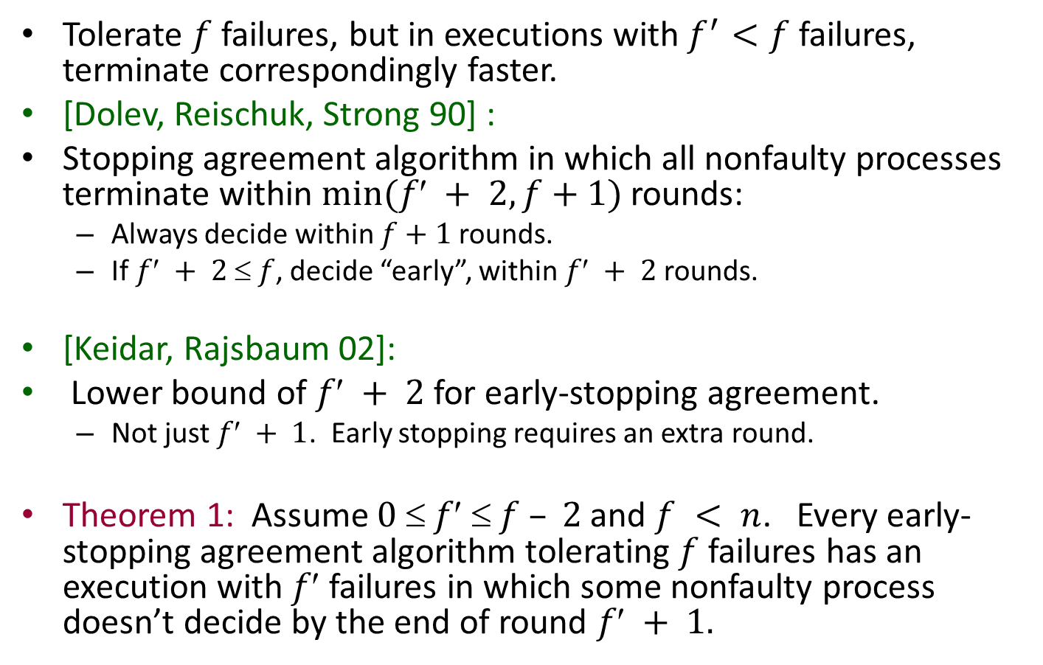
Early-stopping agreement algorithms
Tolerate $f$ failures, but in executions with$f^{′}<f$failures, terminate correspondingly faster.
[Dolev, Reischuk, Strong 90] :
Stopping agreement algorithm in which all nonfaulty processes terminate within $min⁡(f + 2, f+1)$rounds:
Always decide within $f+1$rounds.
If $f + 2  f$, decide “early”, within $f + 2$rounds.
[Keidar, Rajsbaum 02]:
Lower bound of $f + 2$for early-stopping agreement.
Not just $f + 1$. Early stopping requires an extra round.
Theorem 1: Assume $0  f  f – 2$and $f < n$. Every early-stopping agreement algorithm tolerating $f$ failures has an execution with $f$ failures in which some nonfaulty process doesn’t decide by the end of round $f + 1.$
Notes:
But first, tying up a loose end from last time.
This is for stopping agreement.

Slide 21

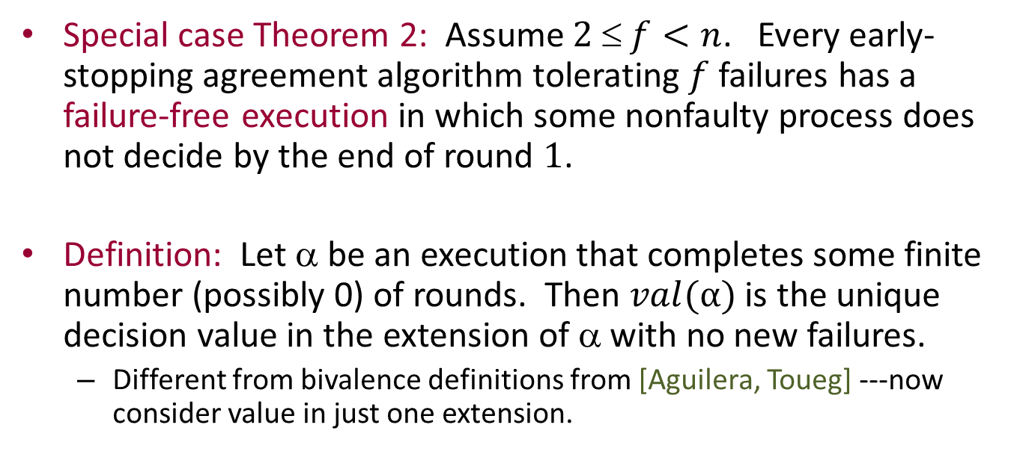
Special case: $f = 0$
Special case Theorem 2: Assume $2  f<n$. Every early-stopping agreement algorithm tolerating $f$ failures has a failure-free execution in which some nonfaulty process does not decide by the end of round $1$.
Definition: Let α be an execution that completes some finite number (possibly 0) of rounds. Then $val(α)$ is the unique decision value in the extension of α with no new failures.
Different from bivalence definitions from [Aguilera, Toueg] ---now consider value in just one extension.
Notes:
We’ll see the basic idea by doing a special case, where f’ = 0.

Slide 22

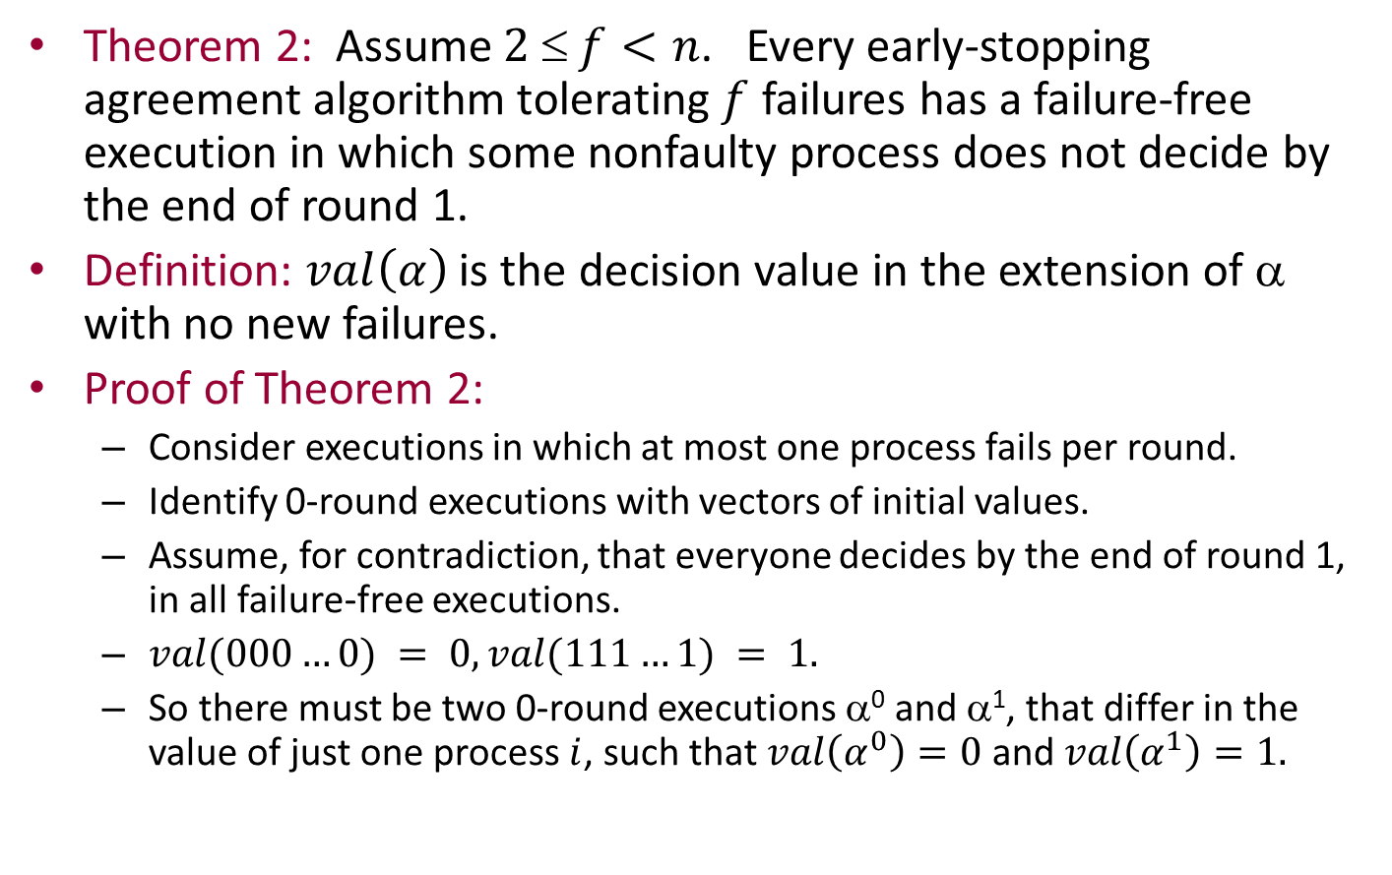
Special case: $f = 0$
Theorem 2: Assume $2  f<n$. Every early-stopping agreement algorithm tolerating $f$ failures has a failure-free execution in which some nonfaulty process does not decide by the end of round 1.
Definition: $val\left(α\right)$ is the decision value in the extension of α with no new failures.
Proof of Theorem 2:
Consider executions in which at most one process fails per round.
Identify 0-round executions with vectors of initial values.
Assume, for contradiction, that everyone decides by the end of round 1, in all failure-free executions.
$val(000…0) = 0, val(111…1) = 1.$
So there must be two 0-round executions α⁰ and α¹, that differ in the value of just one process $i$, such that $val\left(α^{0}\right)=0$ and $val\left(α^{1}\right)=1.$
Notes:
Again assume the special executions, one process failing per round (at most).

Slide 23
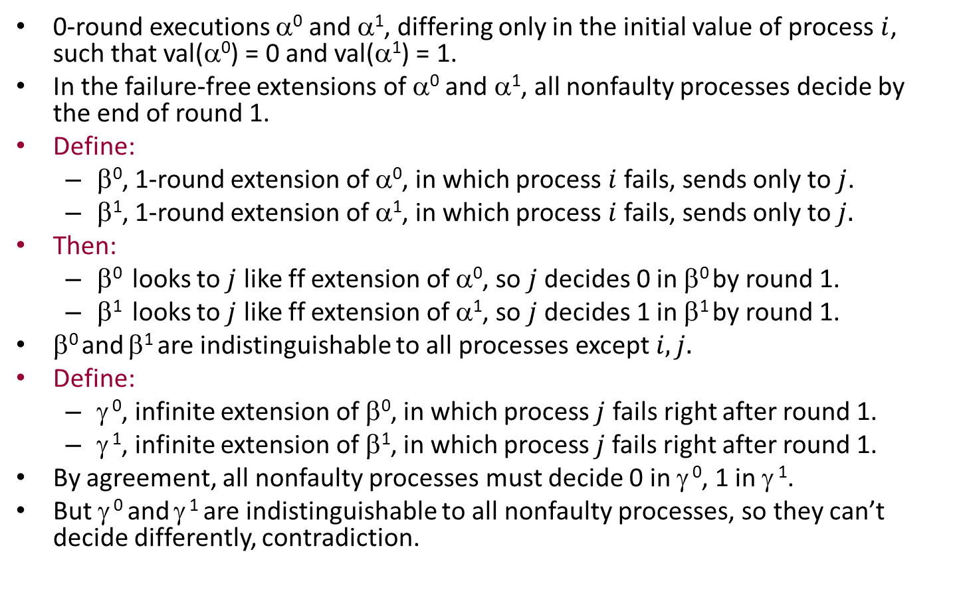
Special case: $f = 0$
0-round executions α⁰ and α¹, differing only in the initial value of process $i$, such that val(α⁰) = 0 and val(α¹) = 1.
In the failure-free extensions of α⁰ and α¹, all nonfaulty processes decide by the end of round 1.
Define:
β⁰, 1-round extension of α⁰, in which process $i$ fails, sends only to $j$.
β¹, 1-round extension of α¹, in which process $i$ fails, sends only to $j.$
Then:
β⁰ looks to $j$ like ff extension of α⁰, so $j$ decides 0 in β⁰ by round 1.
β¹ looks to $j$ like ff extension of α¹, so $j$ decides 1 in β¹ by round 1.
β⁰ and β¹ are indistinguishable to all processes except $i, j.$
Define:
γ ⁰, infinite extension of β⁰, in which process $j$ fails right after round 1.
γ ¹, infinite extension of β¹, in which process $j$fails right after round 1.
By agreement, all nonfaulty processes must decide 0 in γ ⁰, 1 in γ ¹.
But γ ⁰ and γ ¹ are indistinguishable to all nonfaulty processes, so they can’t decide differently, contradiction.
Notes:
Our invocation of the agreement property is using uniform agreement---because j has failed.
Note that the other processes aren’t required to decide by round 1, since this isn’t a ff execution.

Slide 24

$k$-Agreement

Slide 25

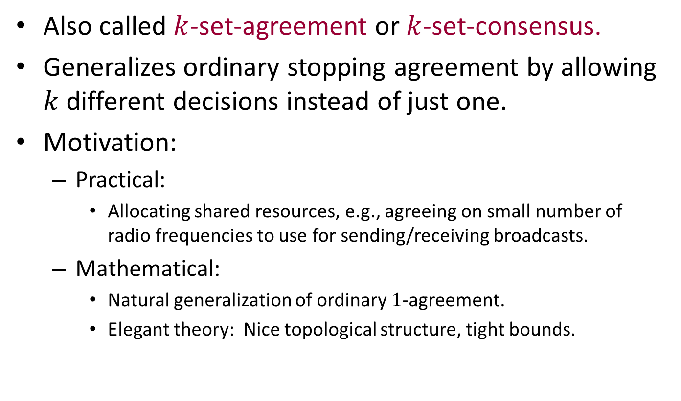
$k$-agreement
Also called $k$-set-agreement or $k$-set-consensus.
Generalizes ordinary stopping agreement by allowing $k$ different decisions instead of just one.
Motivation:
Practical:
Allocating shared resources, e.g., agreeing on small number of radio frequencies to use for sending/receiving broadcasts.
Mathematical:
Natural generalization of ordinary $1$-agreement.
Elegant theory: Nice topological structure, tight bounds.
Notes:
This will illustrate some interesting topological-style arguments that have been used in solving other problems.

Slide 26
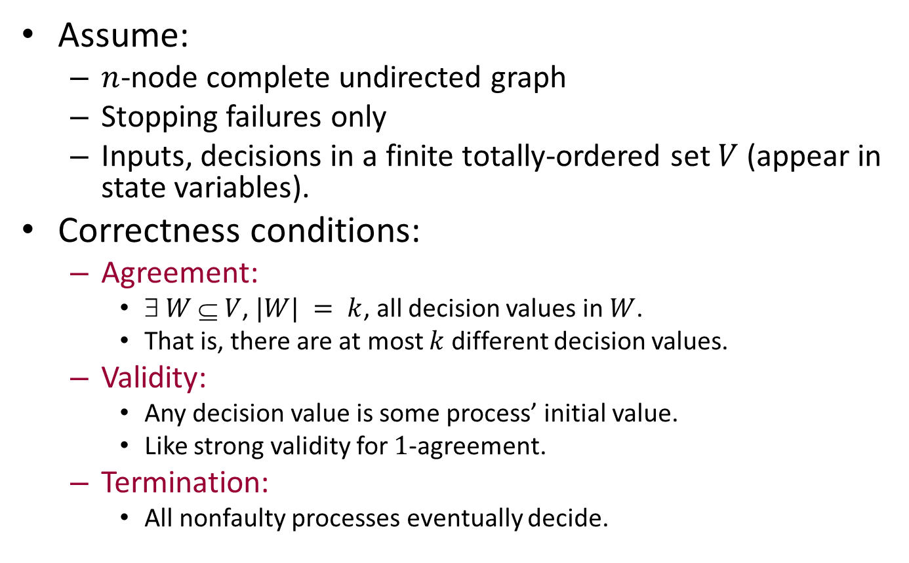

The $k$-agreement problem
Assume:
$n$-node complete undirected graph
Stopping failures only
Inputs, decisions in a finite totally-ordered set $V$ (appear in state variables).
Correctness conditions:
Agreement:
$ W  V$, $|W| = k$, all decision values in $W$.
That is, there are at most $k$ different decision values.
Validity:
Any decision value is some process’ initial value.
Like strong validity for $1$-agreement.
Termination:
All nonfaulty processes eventually decide.

Slide 27

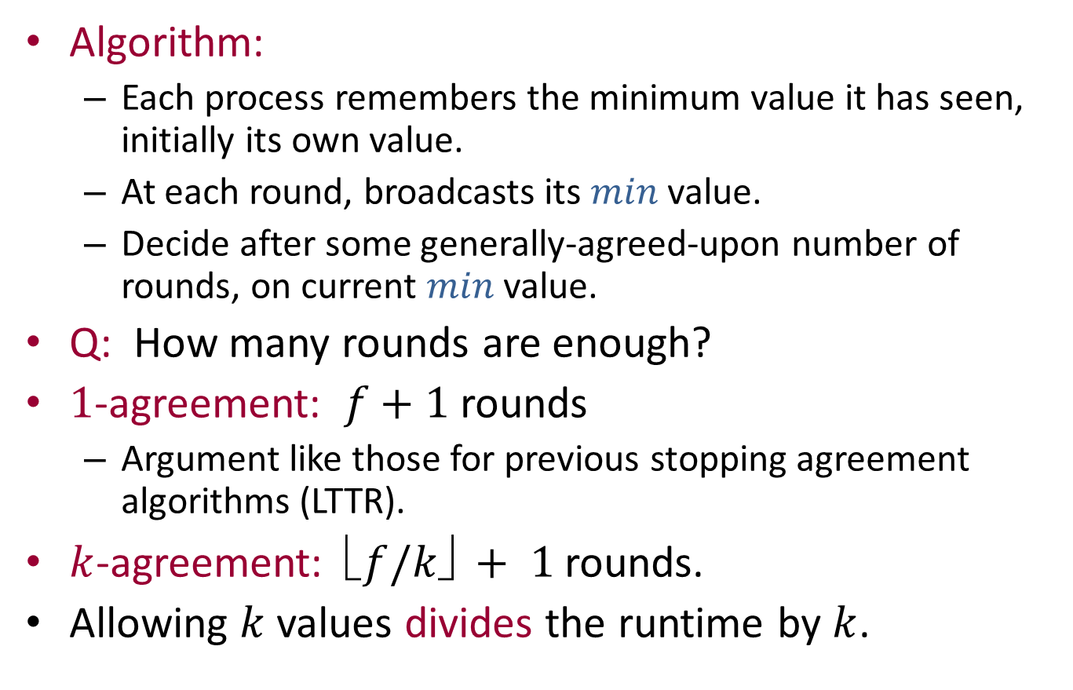
$FloodMin$ $k$-agreement algorithm
Algorithm:
Each process remembers the minimum value it has seen, initially its own value.
At each round, broadcasts its $min$ value.
Decide after some generally-agreed-upon number of rounds, on current $min$ value.
Q: How many rounds are enough?
$1$-agreement: $f+1$ rounds
Argument like those for previous stopping agreement algorithms (LTTR).
$k$-agreement: $f/k✗ + 1$rounds.
Allowing $k$ values divides the runtime by $k$.
Notes:
This seems surprising. Divide the time requirements by k.

Slide 28
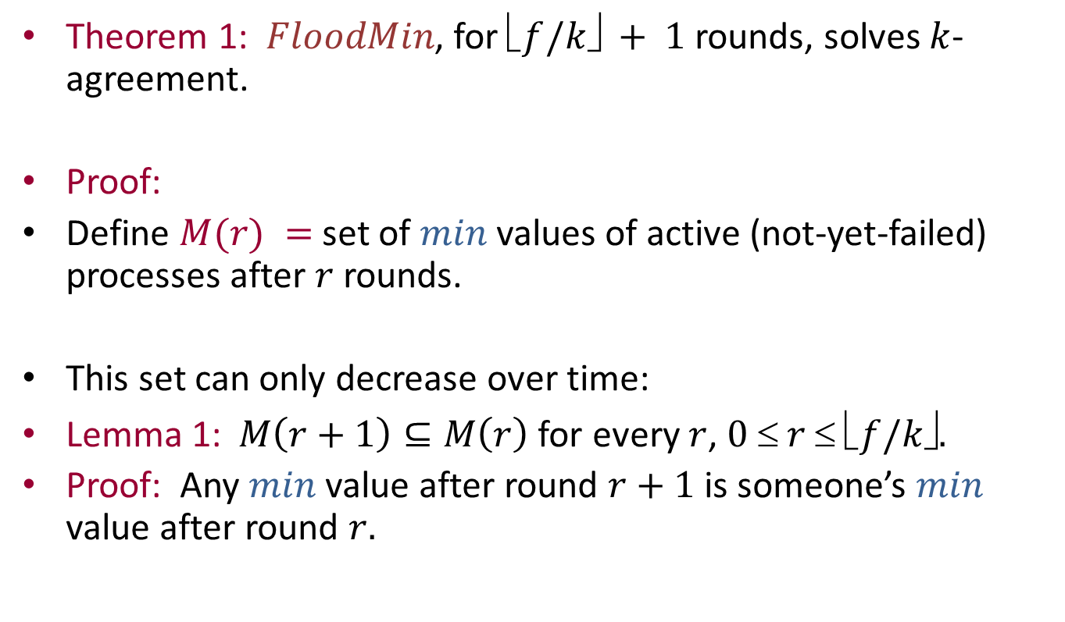

$FloodMin$ correctness
Theorem 1: $FloodMin$, for $f/k✗ + 1$rounds, solves $k$-agreement.
Proof:
Define $M(r) =$set of $min$ values of active (not-yet-failed) processes after $r$ rounds.
This set can only decrease over time:
Lemma 1:$M\left(r+1\right)⊆M\left(r\right)$for every $r$, $0  r  f/k✗.$
Proof: Any $min$ value after round $r+1$ is someone’s $min$ value after round $r.$

Slide 29
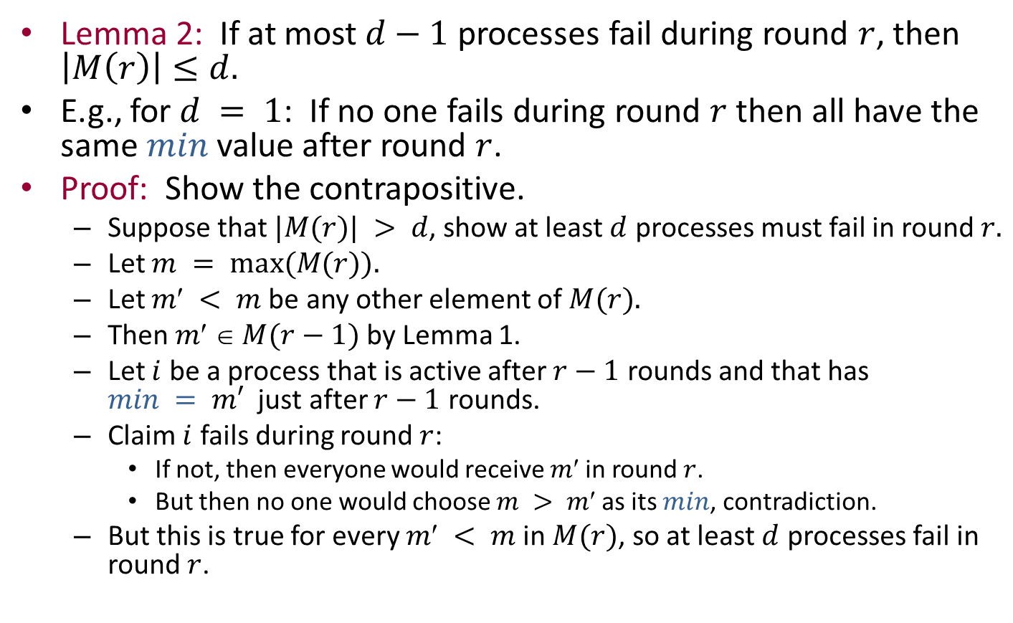
Proof of Theorem 1, cont’d
Lemma 2: If at most $d−1$ processes fail during round $r$, then $\left|M\left(r\right)\right|≤d.$
E.g., for $d = 1$: If no one fails during round $r$ then all have the same $min$value after round $r$.
Proof: Show the contrapositive.
Suppose that $|M(r)| > d$, show at least $d$ processes must fail in round $r.$
Let $m = max⁡(M(r)).$
Let $m < m$be any other element of $M(r).$
Then $m  M(r−1)$by Lemma 1.
Let $i$ be a process that is active after $r−1$ rounds and that has $min = m′$ just after $r−1$ rounds.
Claim $i$ fails during round $r$:
If not, then everyone would receive $m$in round $r$.
But then no one would choose $m > m$as its $min$, contradiction.
But this is true for every $m < m$in $M(r)$, so at least $d$ processes fail in round$r$.
Notes:
At most d different min values are left, if only d-1 fail.

Slide 30
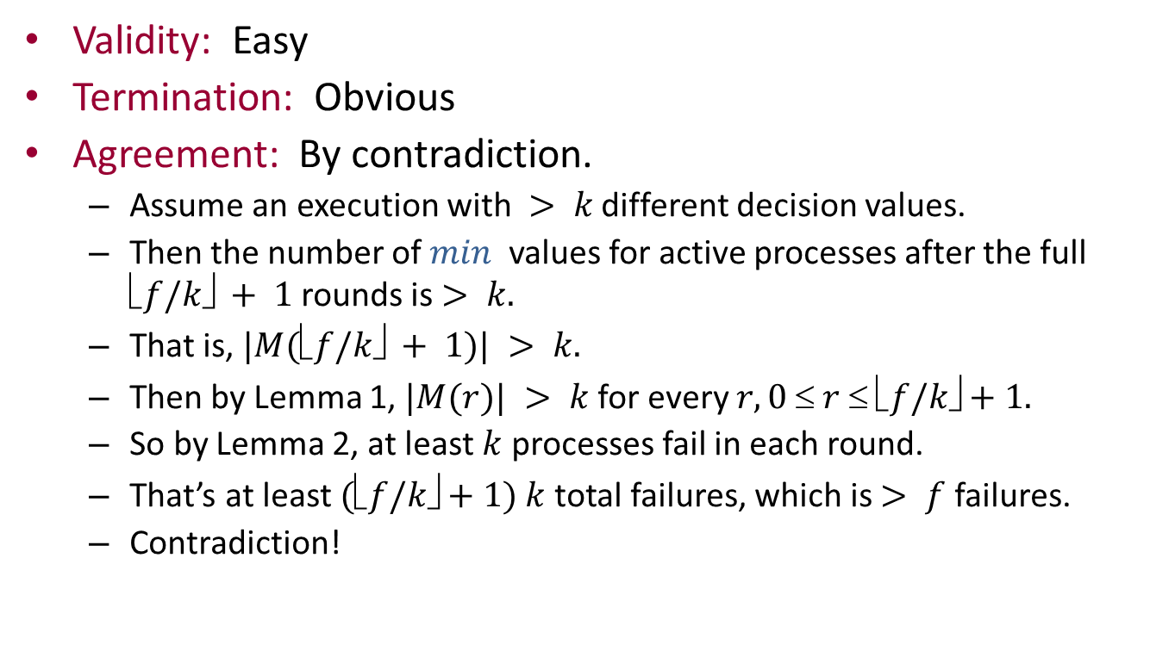
Proof of Theorem 1, cont’d
Validity: Easy
Termination: Obvious
Agreement: By contradiction.
Assume an execution with $> k$ different decision values.
Then the number of $min$ values for active processes after the full $f/k✗ + 1$rounds is $> k.$
That is, $|M(f/k✗ + 1)| > k.$
Then by Lemma 1, $|M(r)| > k$for every $r, 0  r  f/k✗+1.$
So by Lemma 2, at least $k$ processes fail in each round.
That’s at least $(f/k✗+1) k$total failures, which is $> f$ failures.
Contradiction!
Notes:
The set M can only shrink…

Slide 31
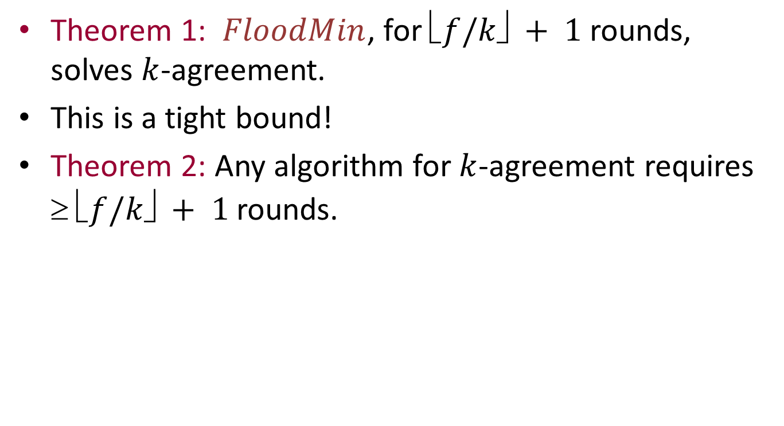

Rounds for $k$-agreement
Theorem 1: $FloodMin$, for $f/k✗ + 1$rounds, solves $k$-agreement.
This is a tight bound!
Theorem 2: Any algorithm for $k$-agreement requires $ f/k✗ + 1$rounds.

Slide 32
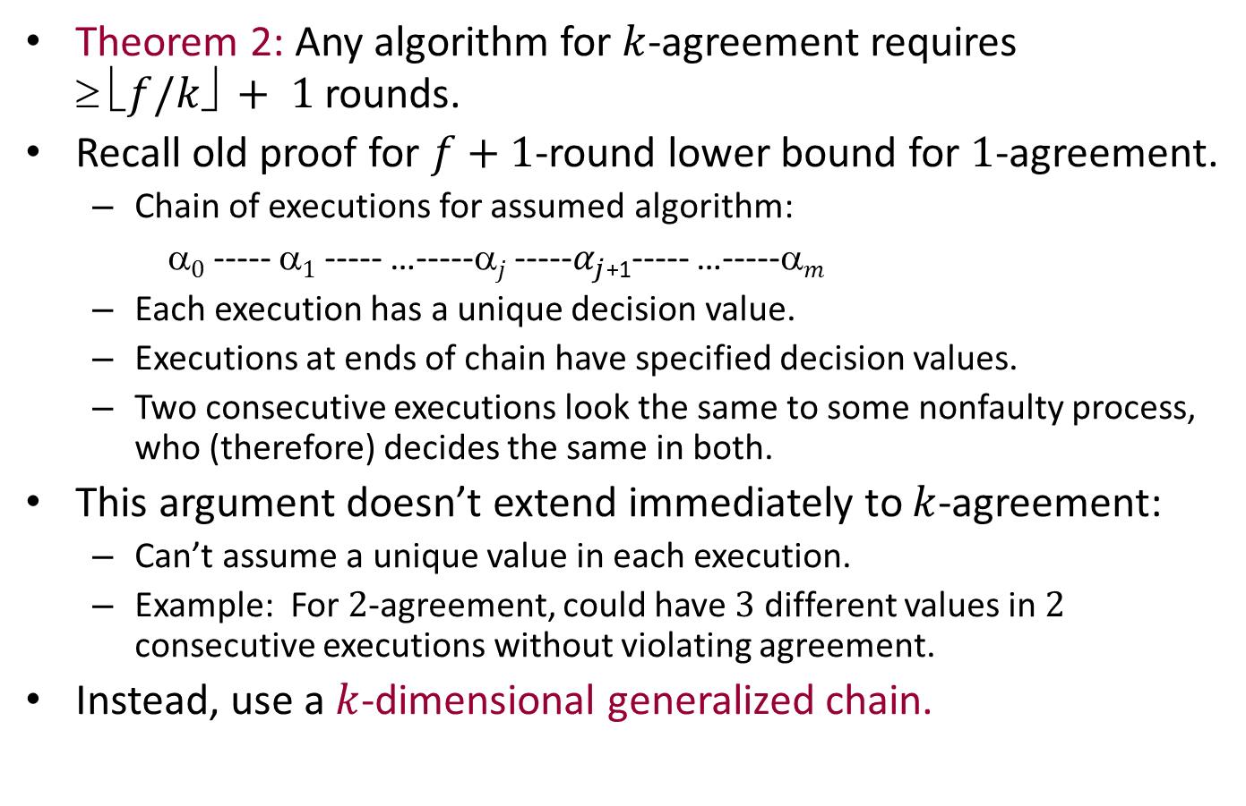
Lower Bound (sketch)
Theorem 2: Any algorithm for $k$-agreement requires $ f/k✗ + 1$rounds.
Recall old proof for $f+1$-round lower bound for $1$-agreement.
Chain of executions for assumed algorithm:
α$0$ ----- α$1$ ----- …-----α$j$ -----$α_{j}$₊₁----- …-----α$m$
Each execution has a unique decision value.
Executions at ends of chain have specified decision values.
Two consecutive executions look the same to some nonfaulty process, who (therefore) decides the same in both.
This argument doesn’t extend immediately to $k$-agreement:
Can’t assume a unique value in each execution.
Example: For $2$-agreement, could have $3$ different values in $2$ consecutive executions without violating agreement.
Instead, use a $k$-dimensional generalized chain.

Slide 33
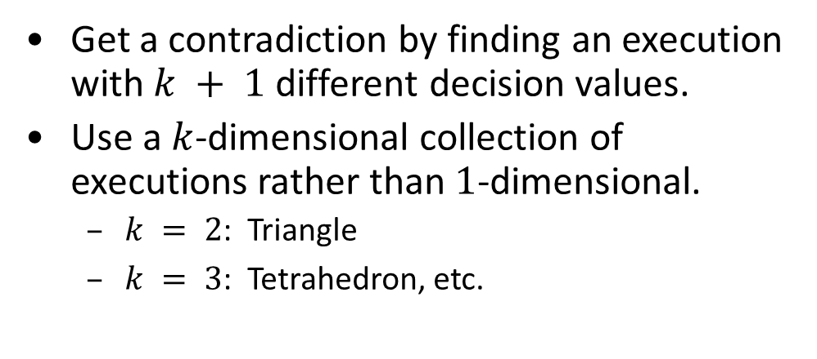
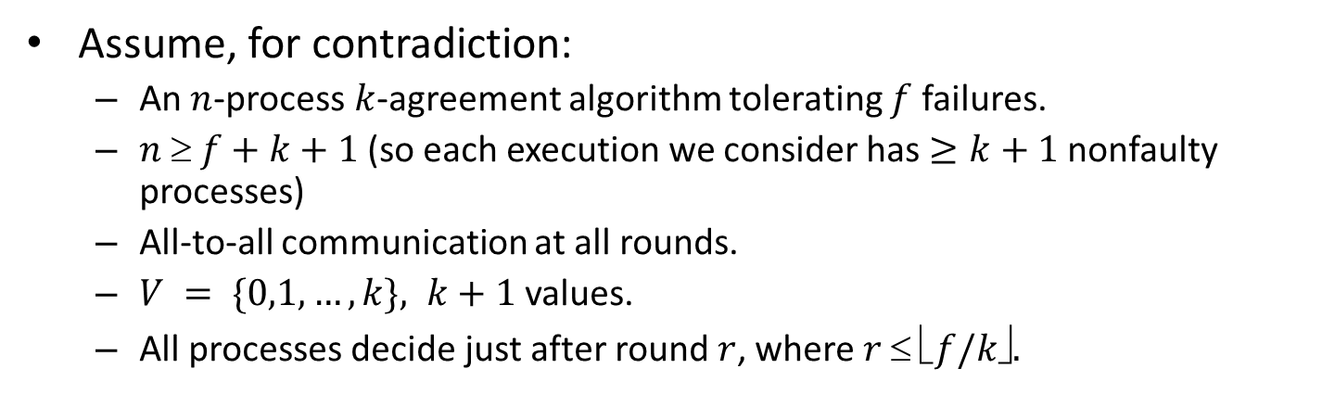
Lower bound
Assume, for contradiction:
An $n$-process $k$-agreement algorithm tolerating $f$ failures.
$n  f+k+1$(so each execution we consider has $≥k+1$nonfaulty processes)
All-to-all communication at all rounds.
$V = \{0,1,…,k\}, k+1$values.
All processes decide just after round $r$, where $r  f/k✗.$
Get a contradiction by finding an execution with $k + 1$different decision values.
Use a $k$-dimensional collection of executions rather than $1$-dimensional.
$k = 2$: Triangle
$k = 3$: Tetrahedron, etc.

Slide 34
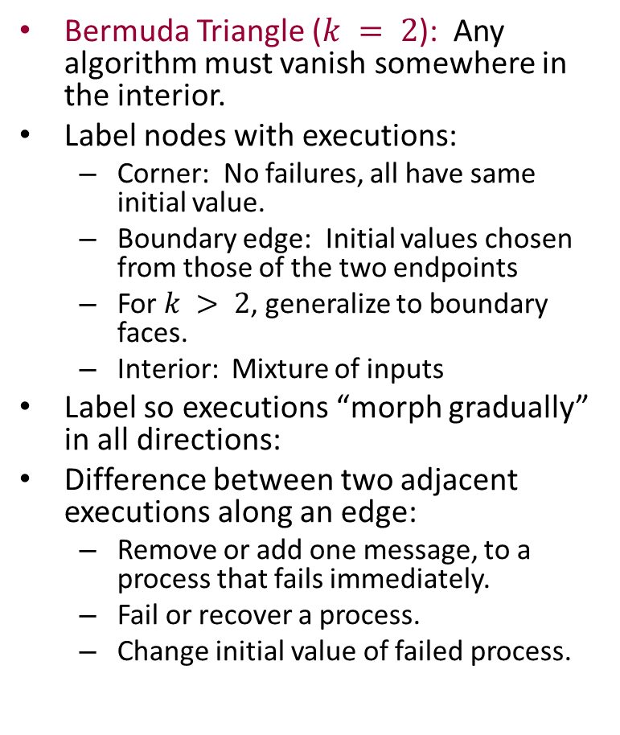
Labeling nodes with executions
Bermuda Triangle ($k = 2$): Any algorithm must vanish somewhere in the interior.
Label nodes with executions:
Corner: No failures, all have same initial value.
Boundary edge: Initial values chosen from those of the two endpoints
For $k > 2$, generalize to boundary faces.
Interior: Mixture of inputs
Label so executions “morph gradually” in all directions:
Difference between two adjacent executions along an edge:
Remove or add one message, to a process that fails immediately.
Fail or recover a process.
Change initial value of failed process.
Initial values
All 0s
0s and 2s
0s and 1s
All 2s
1s and 2s
All 1s
Notes:
These changes are like those that occur in the one-dimensional chains we have studied.

Slide 35
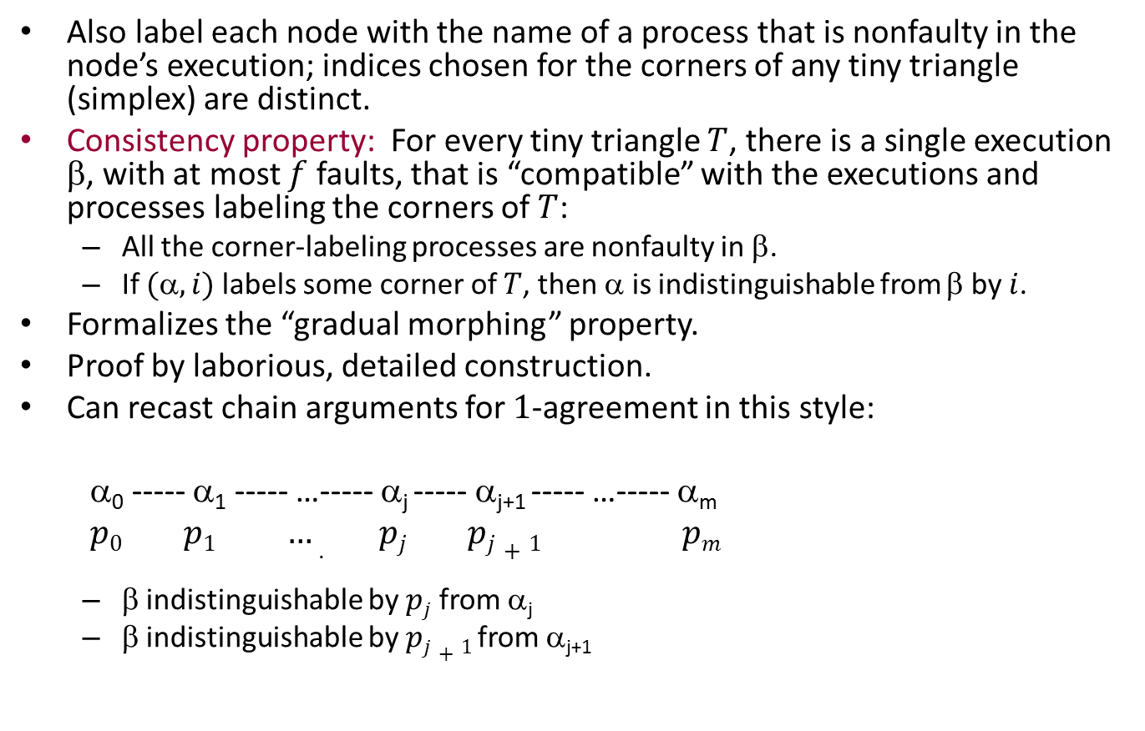
Labeling nodes with process names
Also label each node with the name of a process that is nonfaulty in the node’s execution; indices chosen for the corners of any tiny triangle (simplex) are distinct.
Consistency property: For every tiny triangle $T$, there is a single execution $$, with at most $f$ faults, that is “compatible” with the executions and processes labeling the corners of $T$:
All the corner-labeling processes are nonfaulty in β.
If $(,i)$labels some corner of $T$, then $$ is indistinguishable from β by $i$.
Formalizes the “gradual morphing” property.
Proof by laborious, detailed construction.
Can recast chain arguments for $1$-agreement in this style:
α₀ ----- α₁ ----- …----- α_{j} ----- α_{j+1} ----- …----- α_{m}
$p0 p1 …. pj pj+1 pm$
β indistinguishable by $pj$ from α_{j}
β indistinguishable by $pj+1$ from α_{j+1}
β

Slide 36
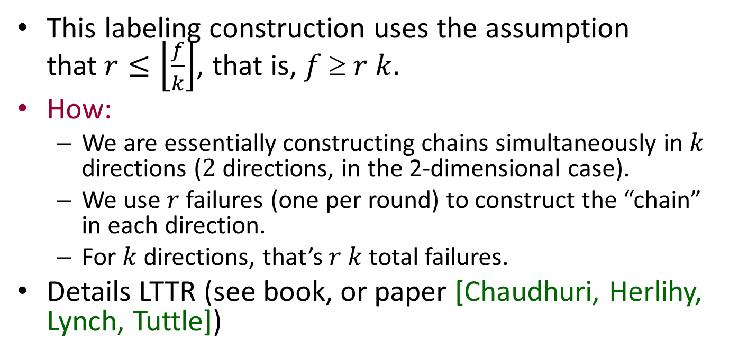
Bound on rounds
This labeling construction uses the assumption that$r≤\left\lfloor \frac{f}{k}\right\rfloor$, that is, $f  r k.$
How:
We are essentially constructing chains simultaneously in $k$ directions ($2$ directions, in the 2-dimensional case).
We use $r$ failures (one per round) to construct the “chain” in each direction.
For $k$ directions, that’s $r k$ total failures.
Details LTTR (see book, or paper [Chaudhuri, Herlihy, Lynch, Tuttle])

Slide 37
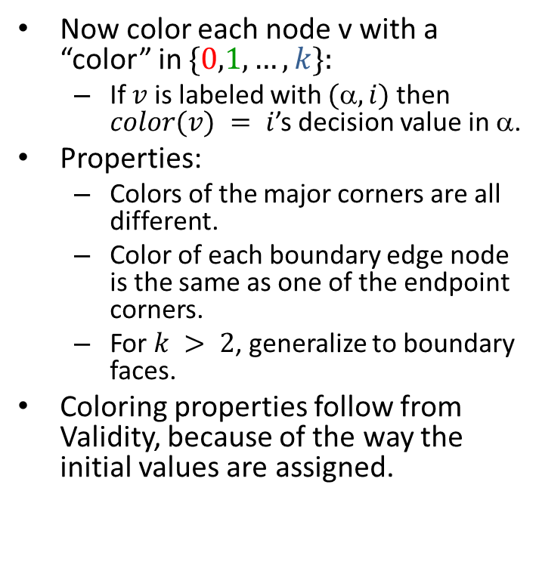
Coloring the nodes
Now color each node v with a “color” in $\{0,1,…,k\}:$
If $v$ is labeled with $(,i)$then $color(v) = i$’s decision value in α.
Properties:
Colors of the major corners are all different.
Color of each boundary edge node is the same as one of the endpoint corners.
For $k > 2$, generalize to boundary faces.
Coloring properties follow from Validity, because of the way the initial values are assigned.
All 0s
0s and 2s
0s and 1s
All 2s
1s and 2s
All 1s
Notes:
Properties must be suitably generalized to k dimensions.
E.g., for tetrahedron, all nodes on a triangular external face must be colored one of the three colors of the corners of that face.

Slide 38
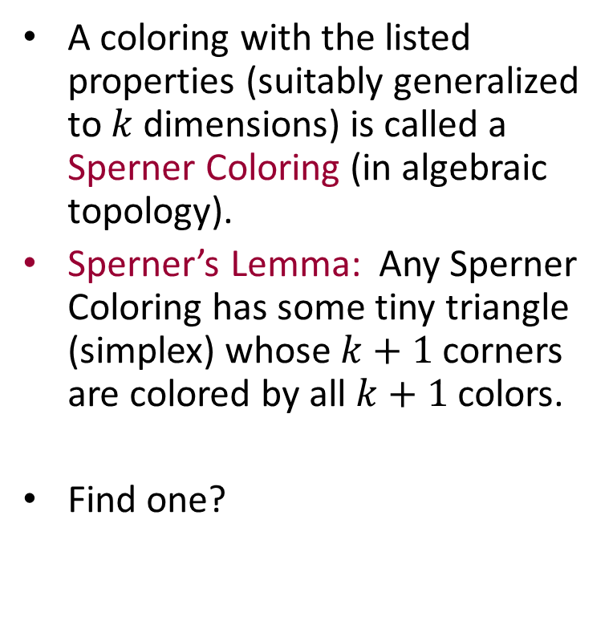
Sperner Colorings
A coloring with the listed properties (suitably generalized to $k$dimensions) is called a Sperner Coloring (in algebraic topology).
Sperner’s Lemma: Any Sperner Coloring has some tiny triangle (simplex) whose $k+1$ corners are colored by all $k+1$ colors.
Find one?
All 0s
0s and 2s
0s and 1s
All 2s
1s and 2s
All 1s
Notes:
Go back and check the example to verify that Sperner seems to hold.

Slide 39
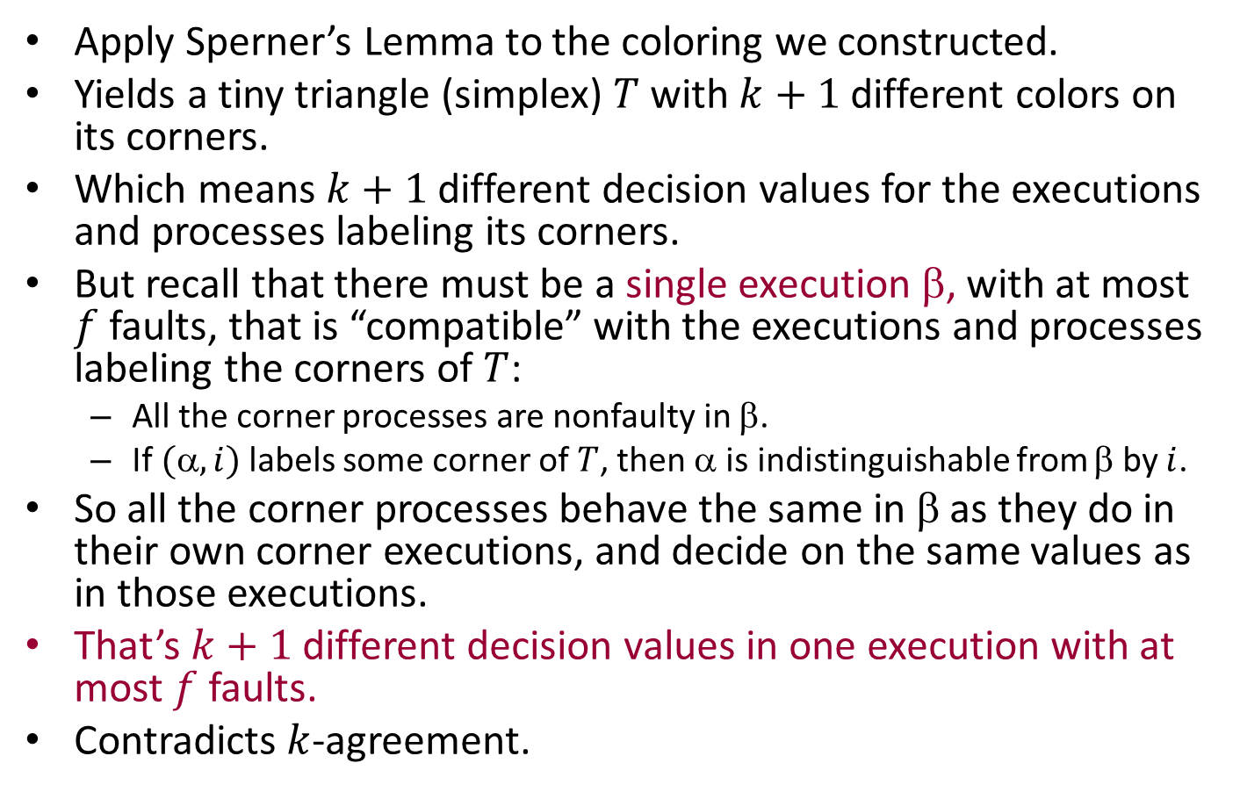
Applying Sperner’s Lemma
Apply Sperner’s Lemma to the coloring we constructed.
Yields a tiny triangle (simplex) $T$ with $k+1$different colors on its corners.
Which means $k+1$different decision values for the executions and processes labeling its corners.
But recall that there must be a single execution β, with at most $f$ faults, that is “compatible” with the executions and processes labeling the corners of $T$:
All the corner processes are nonfaulty in β.
If $(,i)$labels some corner of $T$, then α is indistinguishable from β by $i$.
So all the corner processes behave the same in β as they do in their own corner executions, and decide on the same values as in those executions.
That’s $k+1$ different decision values in one execution with at most $f$ faults.
Contradicts $k$-agreement.

Slide 40
Approximate Agreement

Slide 41
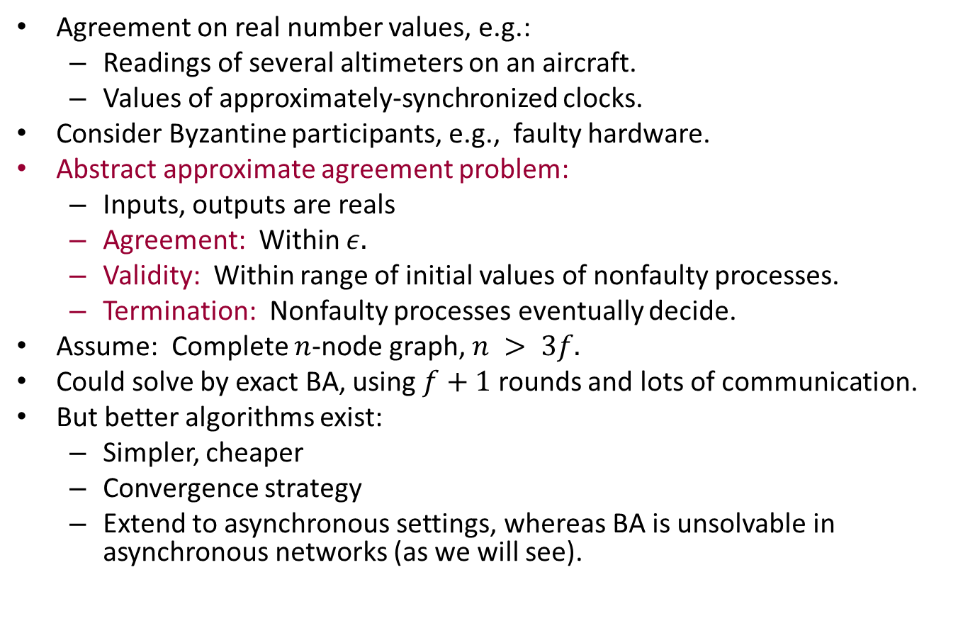
Approximate Agreement problem
Agreement on real number values, e.g.:
Readings of several altimeters on an aircraft.
Values of approximately-synchronized clocks.
Consider Byzantine participants, e.g., faulty hardware.
Abstract approximate agreement problem:
Inputs, outputs are reals
Agreement: Within $ε.$
Validity: Within range of initial values of nonfaulty processes.
Termination: Nonfaulty processes eventually decide.
Assume: Complete $n$-node graph, $n > 3f.$
Could solve by exact BA, using $f+1$ rounds and lots of communication.
But better algorithms exist:
Simpler, cheaper
Convergence strategy
Extend to asynchronous settings, whereas BA is unsolvable in asynchronous networks (as we will see).
Notes:
This last is an important point, that we will come back to. The ideas here work in the asynchronous setting too. However, exact agreement algorithms do not extend. We will see this shortly.

Slide 42
Distributed Commit

Slide 43
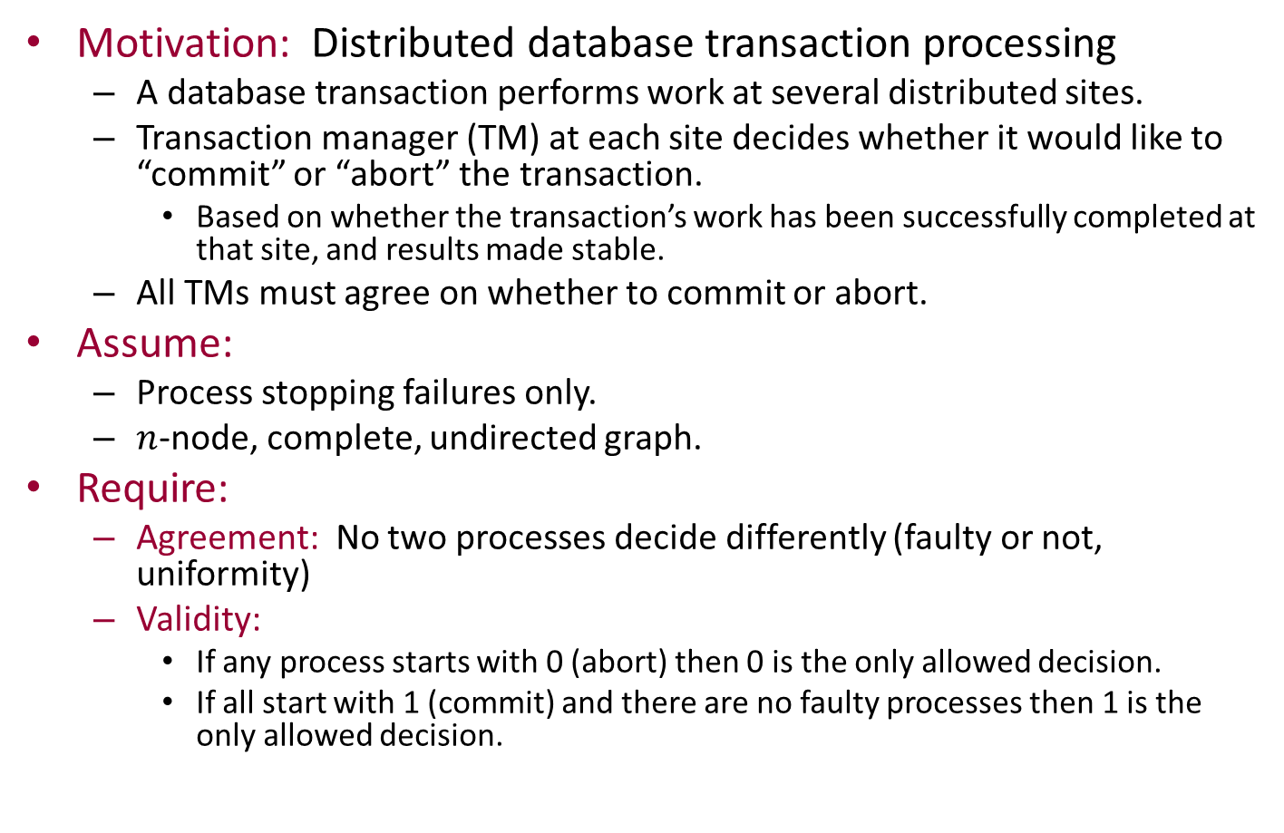
Distributed Commit
Motivation: Distributed database transaction processing
A database transaction performs work at several distributed sites.
Transaction manager (TM) at each site decides whether it would like to “commit” or “abort” the transaction.
Based on whether the transaction’s work has been successfully completed at that site, and results made stable.
All TMs must agree on whether to commit or abort.
Assume:
Process stopping failures only.
$n$-node, complete, undirected graph.
Require:
Agreement: No two processes decide differently (faulty or not, uniformity)
Validity:
If any process starts with 0 (abort) then 0 is the only allowed decision.
If all start with 1 (commit) and there are no faulty processes then 1 is the only allowed decision.
Notes:
Similar to one version of the 2-generals problem.

Slide 44
Correctness Conditions for Commit
Agreement: No two processes decide differently.
Validity:
If any process starts with 0 then 0 is the only allowed decision.
If all start with 1 and there are no faulty processes then 1 is the only allowed decision.
Note the asymmetry: Guarantee abort (0) if anyone wants to abort; guarantee commit (1) if everyone wants to commit and no one fails (best case).
Termination:
Weak termination: If there are no failures then all processes eventually decide.
Strong termination (non-blocking condition): (Even if there are failures), all nonfaulty processes eventually decide.

Slide 45




2-Phase Commit
Traditional, blocking algorithm (guarantees weak termination only).
Assumes distinguished process 1, acts as “coordinator” (leader).
Round 1: All send initial values to process 1, who decides.
If it sees 0, or doesn’t hear from someone, it decides 0; otherwise it decides 1.
Round 2: Process 1 sends the decision to everyone else.
$$p_{1}$$
$$p_{2}$$
$$p_{3}$$
$$p_{4}$$
Q: When can the processes decide?
Anyone with initial value 0 can decide at the beginning.
Process 1 decides after receiving round 1 messages.
Everyone else decides after round 2 (if there are no failures).
Notes:
How can they decide after round 2?
If they hear the decision from the coordinator, they can just decide accordingly.
If not, then not clear what to do…

Slide 46
Correctness of 2-Phase Commit
Agreement:
Because decision is centralized (and consistent with any individual initial decisions).
Validity:
Because of how the coordinator decides.
Weak termination:
If no one fails, everyone terminates by end of round 2.
Strong termination?
No: If coordinator fails before sending its round 2 messages, then others with initial value 1 will never terminate.

Slide 47
Add a termination protocol?
We might try to add a termination protocol: other processes try to detect failure of coordinator and finish agreeing on their own.
But this can’t always work:
If initial values are 0,1,1,1, then by validity, everyone is required to decide 0.
If initial values are 1,1,1,1 and process 1 fails just after deciding, and before sending out its round 2 messages, then:
Process 1 will decide 1.
By agreement, others must decide 1.
But the other processes can’t distinguish these two situations.
0
1
1
1
1
1
1
1

Slide 48

Complexity of 2-phase commit
Time:
$2$ rounds
Communication:
At most $2n$ messages

Slide 49

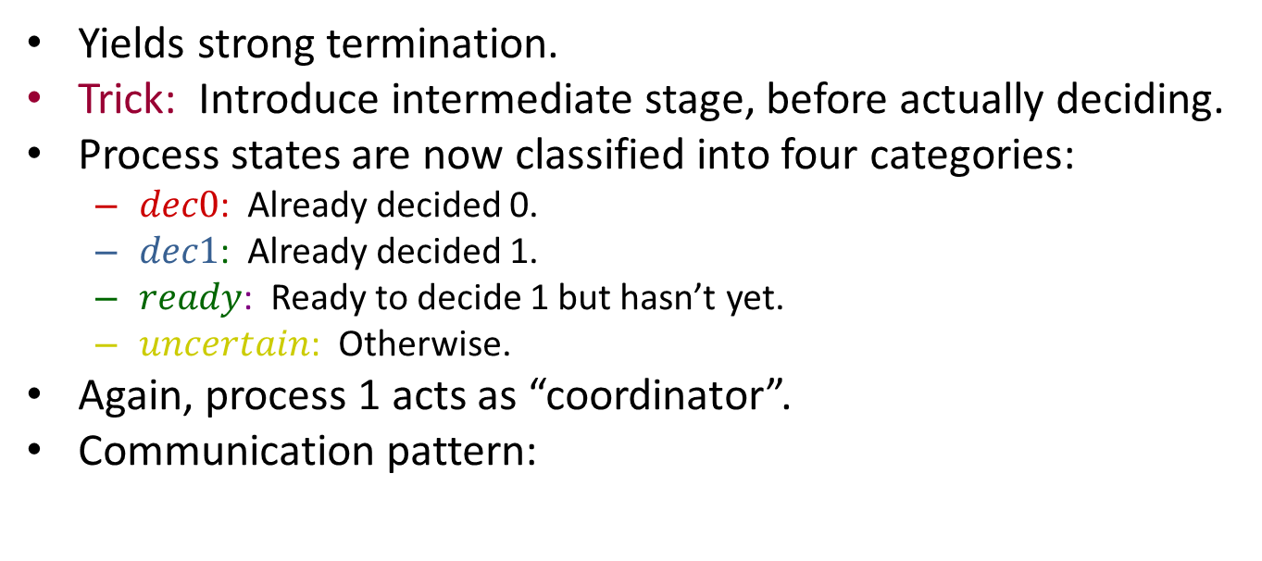
3-Phase Commit [Skeen]
Yields strong termination.
Trick: Introduce intermediate stage, before actually deciding.
Process states are now classified into four categories:
$dec0$: Already decided 0.
$dec1$: Already decided 1.
$ready$: Ready to decide 1 but hasn’t yet.
$uncertain$: Otherwise.
Again, process 1 acts as “coordinator”.
Communication pattern:
$$p_{1}$$

Slide 50
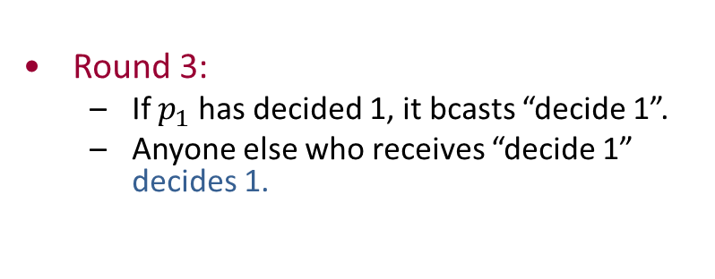
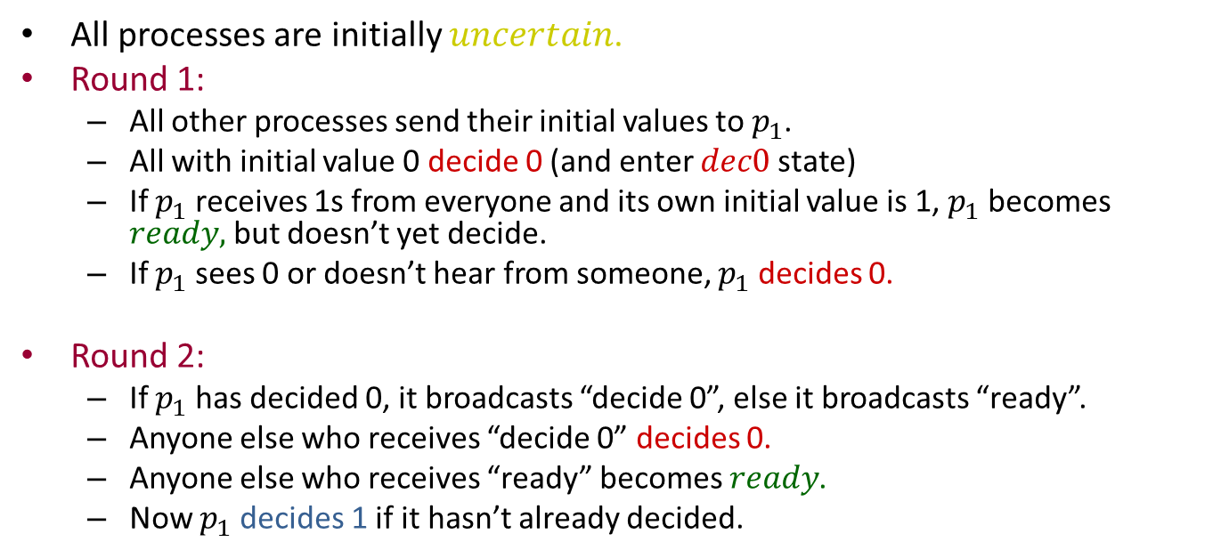
3-Phase Commit
All processes are initially $uncertain$.
Round 1:
All other processes send their initial values to $p_{1}$.
All with initial value 0 decide 0 (and enter $dec0$ state)
If $p_{1}$ receives 1s from everyone and its own initial value is 1, $p_{1}$ becomes $ready,$ but doesn’t yet decide.
If $p_{1}$ sees 0 or doesn’t hear from someone, $p_{1}$ decides 0.
Round 2:
If $p_{1}$ has decided 0, it broadcasts “decide 0”, else it broadcasts “ready”.
Anyone else who receives “decide 0” decides 0.
Anyone else who receives “ready” becomes $ready$.
Now $p_{1}$ decides 1 if it hasn’t already decided.
Round 3:
If $p_{1}$ has decided 1, it bcasts “decide 1”.
Anyone else who receives “decide 1” decides 1.

Slide 51
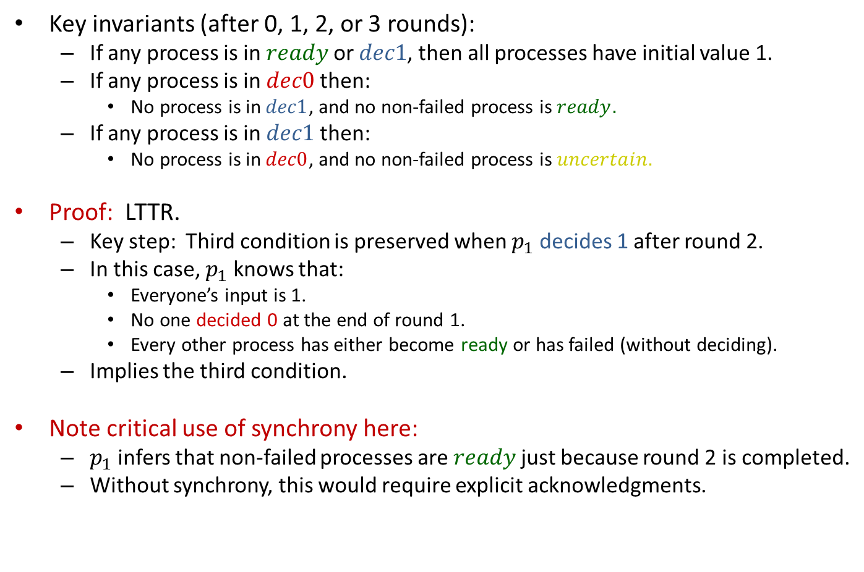
3-Phase Commit
Key invariants (after 0, 1, 2, or 3 rounds):
If any process is in $ready$ or $dec1$, then all processes have initial value 1.
If any process is in $dec0$ then:
No process is in $dec1$, and no non-failed process is $ready.$
If any process is in $dec1$ then:
No process is in $dec0$, and no non-failed process is $uncertain.$
Proof: LTTR.
Key step: Third condition is preserved when $p_{1}$ decides 1 after round 2.
In this case, $p_{1}$ knows that:
Everyone’s input is 1.
No one decided 0 at the end of round 1.
Every other process has either become ready or has failed (without deciding).
Implies the third condition.
Note critical use of synchrony here:
$p_{1}$ infers that non-failed processes are $ready$ just because round 2 is completed.
Without synchrony, this would require explicit acknowledgments.
Notes:
Not yet a complete protocol, but let’s start showing some interesting properties.

Slide 52
Correctness conditions (so far)
Agreement and validity follow, for these three rounds.
Weak termination holds
Strong termination:
Doesn’t hold yet---must add a termination protocol.
Allow process 2 to act as coordinator, then 3,…
“Rotating coordinator” strategy
Notes:
Rotating coordinator strategy is used in other algorithms. E.g., in Dwork, Lynch, Stockmeyer paper, a precursor to Paxos.

Slide 53
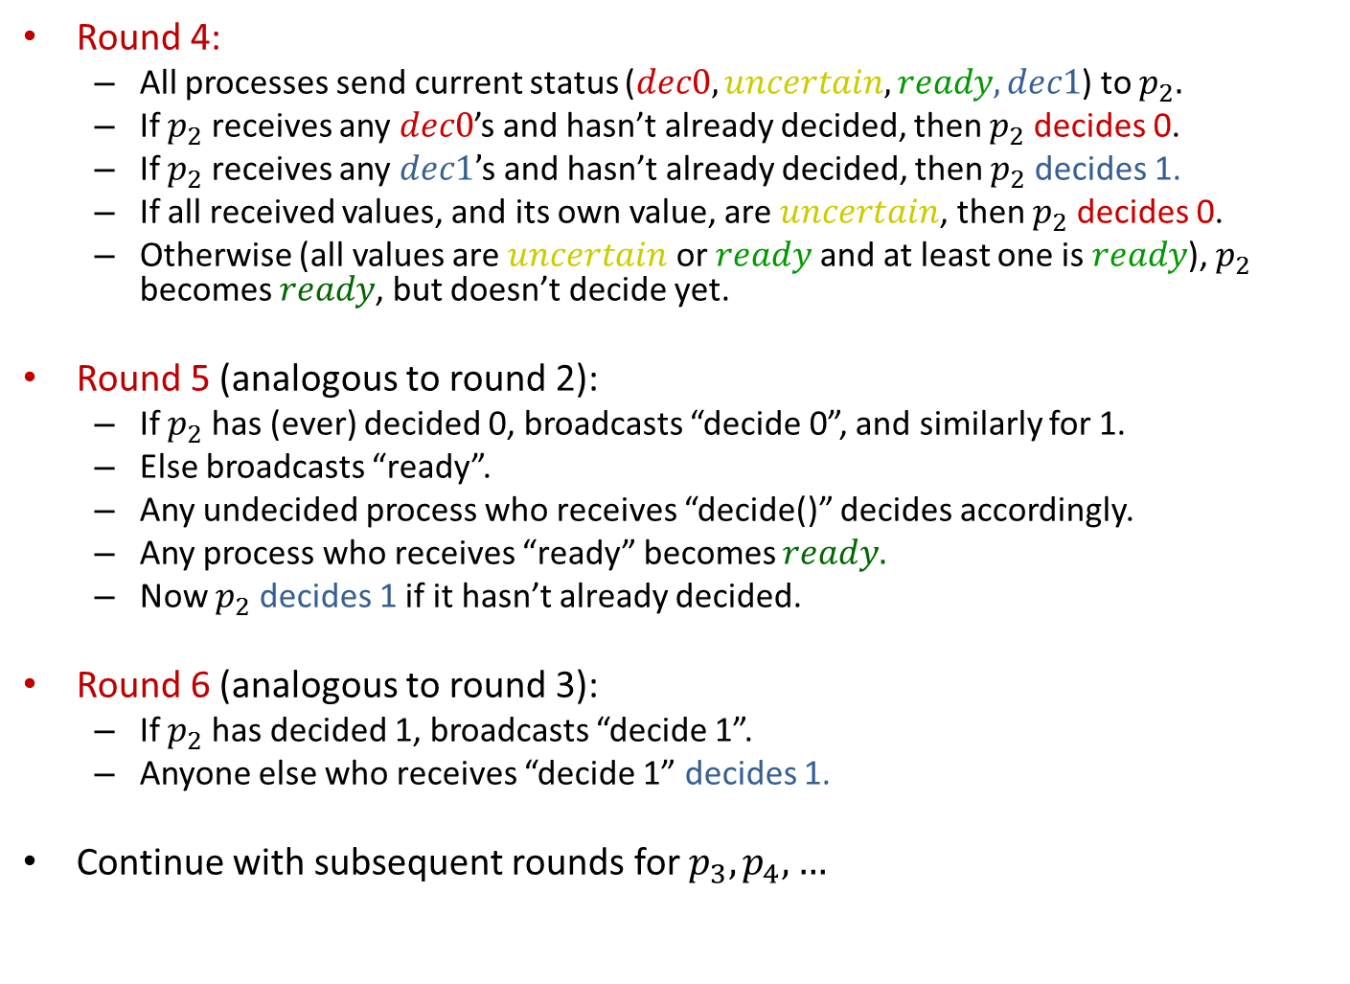
3-Phase Commit
Round 4:
All processes send current status ($dec0, uncertain, ready, dec1$) to $p_{2}.$
If $p_{2}$ receives any $dec0$’s and hasn’t already decided, then $p_{2}$ decides 0.
If $p_{2}$ receives any $dec1’$s and hasn’t already decided, then $p_{2}$ decides 1.
If all received values, and its own value, are $uncertain$, then $p_{2}$ decides 0.
Otherwise (all values are $uncertain$ or $ready$ and at least one is $ready$), $p_{2}$ becomes $ready$, but doesn’t decide yet.
Round 5 (analogous to round 2):
If $p_{2}$ has (ever) decided 0, broadcasts “decide 0”, and similarly for 1.
Else broadcasts “ready”.
Any undecided process who receives “decide()” decides accordingly.
Any process who receives “ready” becomes $ready.$
Now $p_{2}$ decides 1 if it hasn’t already decided.
Round 6 (analogous to round 3):
If $p_{2}$ has decided 1, broadcasts “decide 1”.
Anyone else who receives “decide 1” decides 1.
Continue with subsequent rounds for $p_{3},p_{4},…$

Slide 54
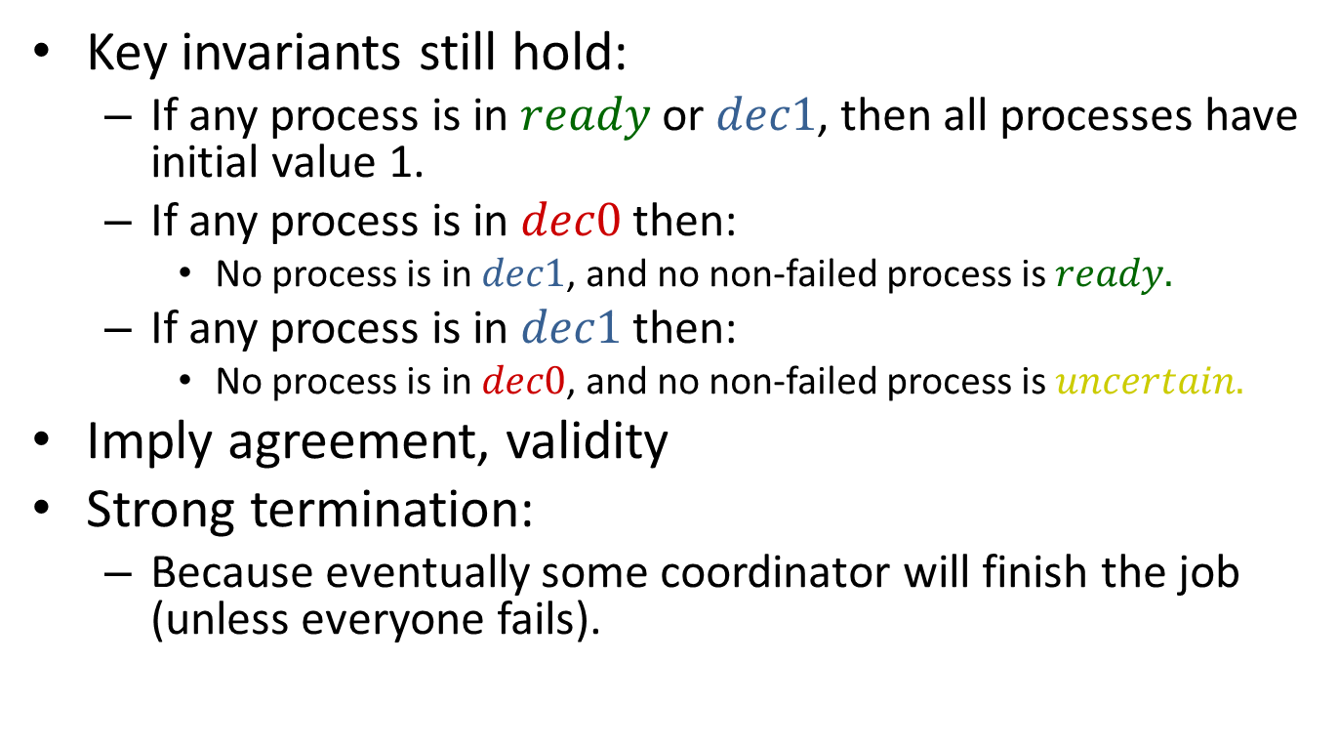
Correctness
Key invariants still hold:
If any process is in $ready$or $dec1$, then all processes have initial value 1.
If any process is in $dec0$ then:
No process is in $dec1$, and no non-failed process is $ready.$
If any process is in $dec1$ then:
No process is in $dec0$, and no non-failed process is $uncertain.$
Imply agreement, validity
Strong termination:
Because eventually some coordinator will finish the job (unless everyone fails).
Notes:
Actually these invariants imply just half of the validity condition---if anyone starts with 0 then 0 is the only possible decision. For the other direction, if everyone starts with 1 and there are no failures, then everyone finishes within 3 rounds with decision 1.

Slide 55
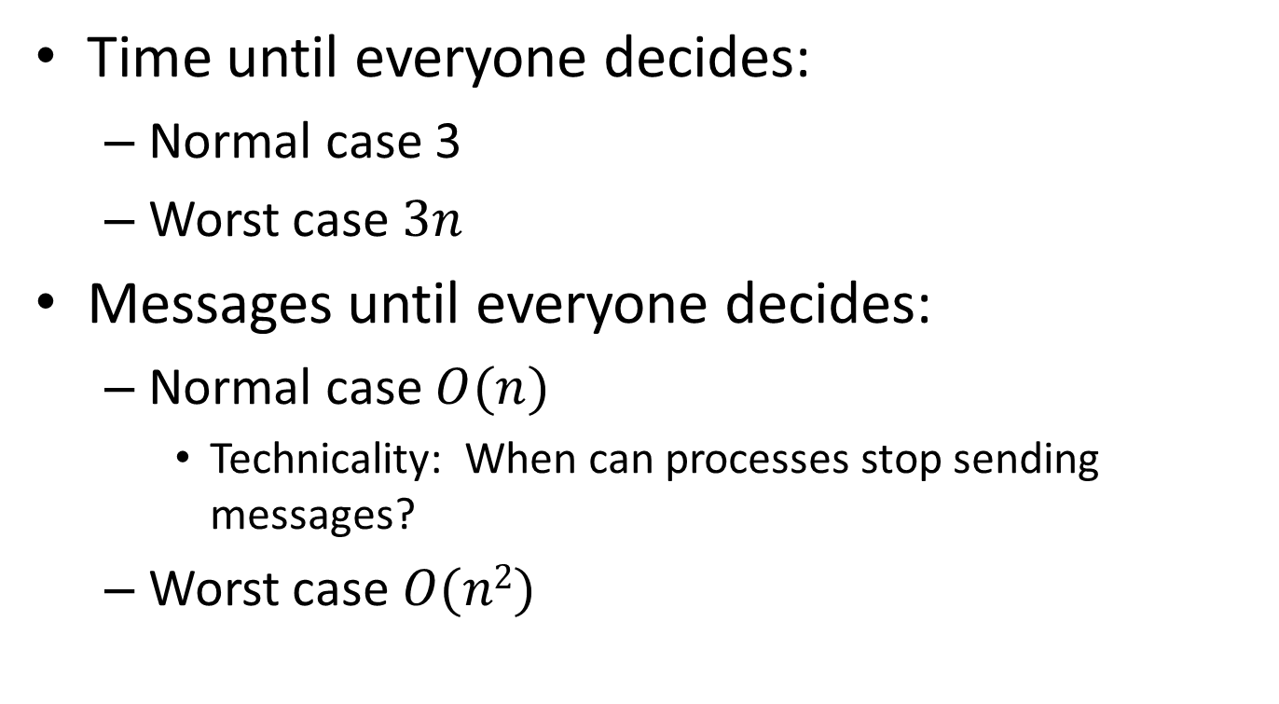
Complexity
Time until everyone decides:
Normal case 3
Worst case $3n$
Messages until everyone decides:
Normal case $O(n)$
Technicality: When can processes stop sending messages?
Worst case $O(n2)$
Notes:
We get a 3n message bound until everyone decides in the normal case, just 3 rounds.
But what if we wanted to bound the TOTAL number of messages in that case? We would need some protocol that allows processes to stop sending messages.
E.g., suppose someone, pi, gets a message at round 4 from p1. Then it knows that p1 succeeded in sending all its messages in round 3, so everyone decided by the end of round 3. Then pi could just halt, and stop sending messages.
Likewise, p1 could halt and stop sending messages after round 4, since it knows everyone who is still alive will get its round 4 messages.
But what if p1 dies in the middle of round 4? So some processes receive its message (and halt) and others don’t. Then the others would just continue the normal protocol, rotating coordinators. It’s just as if the halted processes failed. Since the rotation protocol yields uniform agreement in case they failed, it still works if they halt.
Likewise, a process could halt if it gets a message from p2 at round 7, etc.

Slide 56
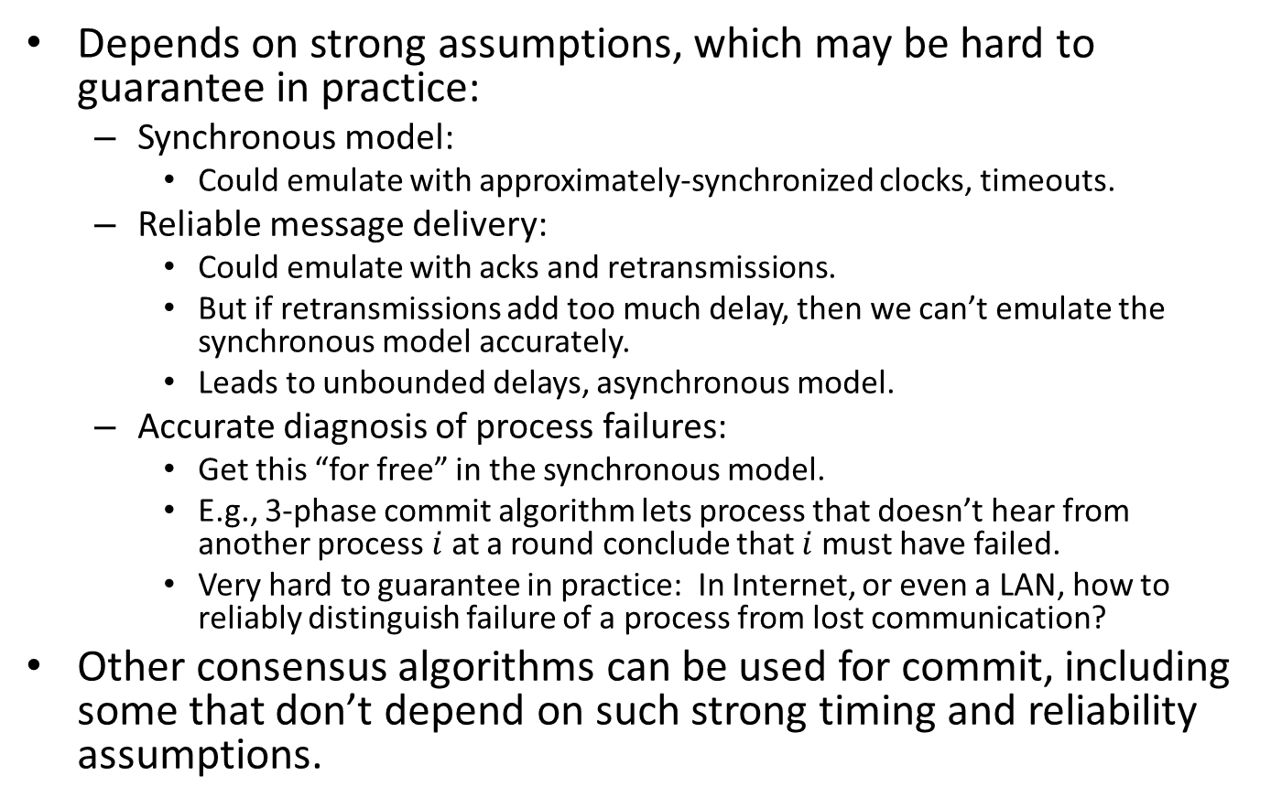
Practical issues for 3-phase commit
Depends on strong assumptions, which may be hard to guarantee in practice:
Synchronous model:
Could emulate with approximately-synchronized clocks, timeouts.
Reliable message delivery:
Could emulate with acks and retransmissions.
But if retransmissions add too much delay, then we can’t emulate the synchronous model accurately.
Leads to unbounded delays, asynchronous model.
Accurate diagnosis of process failures:
Get this “for free” in the synchronous model.
E.g., 3-phase commit algorithm lets process that doesn’t hear from another process $i$ at a round conclude that $i$must have failed.
Very hard to guarantee in practice: In Internet, or even a LAN, how to reliably distinguish failure of a process from lost communication?
Other consensus algorithms can be used for commit, including some that don’t depend on such strong timing and reliability assumptions.

Slide 57
Paxos consensus algorithm [Lamport]
A more robust consensus algorithm, can be used for commit.
Tolerates process stopping and recovery, message losses and delays,…
Runs in partially synchronous model.
Similar to algorithm by [Dwork, Lynch, Stockmeyer].
Algorithm idea:
Processes use an unreliable leader election subalgorithm to choose a coordinator, who tries to achieve consensus.
Coordinator decides based on active support from a majority of the processes.
Does not assume anything based on not receiving a message.
Subtleties arise when multiple coordinators are active---must ensure consistency.
Practical difficulties with fault-tolerance in the synchronous model motivate moving on to study the asynchronous model (start this next time).
Notes:
Will study this algorithm later in the course (asynchronous consensus).
I mean practical difficulties with implementing the fault-prone synchronous model on less well-behaved platforms.

Slide 58
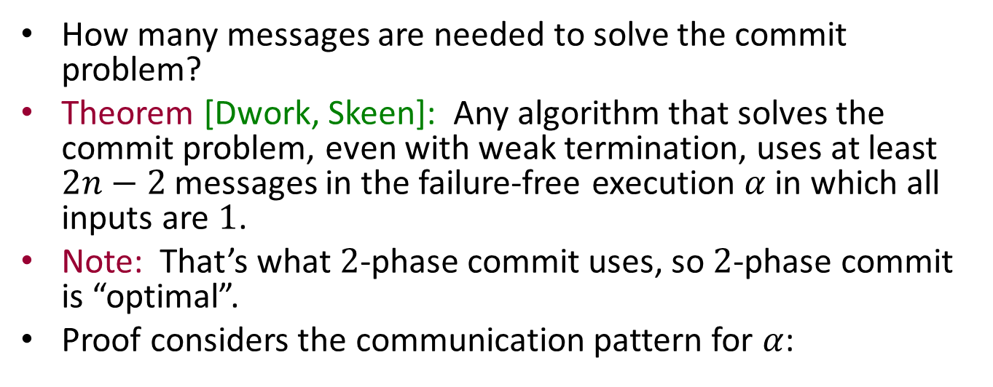




A Lower Bound for Commit
How many messages are needed to solve the commit problem?
Theorem [Dwork, Skeen]: Any algorithm that solves the commit problem, even with weak termination, uses at least $2n−2$messages in the failure-free execution $α$in which all inputs are $1$.
Note: That’s what $2$-phase commit uses, so $2$-phase commit is “optimal”.
Proof considers the communication pattern for $α$:
$$p_{1}$$
$$p_{2}$$
$$p_{3}$$
$$p_{4}$$
Notes:
Weak requirements.
A very particular execution, the best-case one.

Slide 59

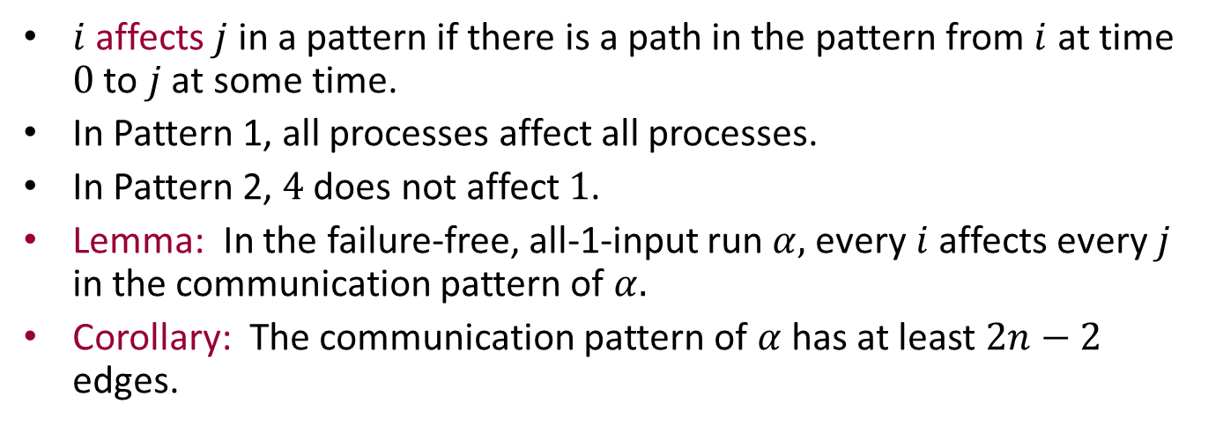







Information flow in a communication pattern
$$p_{1}$$
$$p_{1}$$
$$p_{2}$$
$$p_{2}$$
$$p_{3}$$
$$p_{3}$$
$$p_{4}$$
$$p_{4}$$
$i$ affects $j$ in a pattern if there is a path in the pattern from $i$ at time $0$ to $j$ at some time.
In Pattern 1, all processes affect all processes.
In Pattern 2, $4$ does not affect $1$.
Lemma: In the failure-free, all-1-input run $α,$every $i$affects every $j$ in the communication pattern of $α.$
Corollary: The communication pattern of $α$has at least $2n−2$ edges.
Notes:
4 does not affect 1, but all other pairs do affect each other.
To prove the corollary, we need a calculation, given in the textbook.

Slide 60

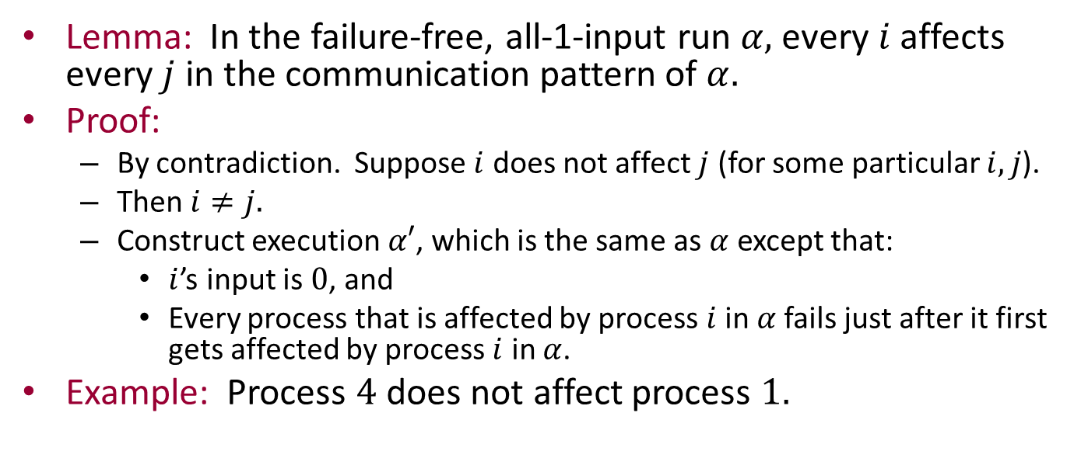







Proof of the Lemma
Lemma: In the failure-free, all-1-input run $α,$every $i$affects every $j$ in the communication pattern of $α.$
Proof:
By contradiction. Suppose $i$ does not affect $j$ (for some particular $i,j$).
Then $i≠j.$
Construct execution $α′$, which is the same as $α$ except that:
$i$’s input is $0$, and
Every process that is affected by process $i$ in $α$fails just after it first gets affected by process $i$ in $α$.
Example: Process $4$ does not affect process $1.$
$$p_{1}$$
$$p_{1}$$
1
1
1
$$p_{2}$$
1
$$p_{2}$$
$$p_{3}$$
$$p_{3}$$
1
1
1
$$p_{4}$$
0
$$p_{4}$$

Slide 61

Proof of the Lemma
Lemma: In the failure-free, all-1-input run $α,$every $i$affects every $j$ in the communication pattern of $α.$
Proof, cont’d:
Construct execution $α′$:
$i$’s input is $0$, and
Every process that is affected by process $i$ in $α$fails just after it first gets affected by process $i$ in $α$.
In $α$, all processes eventually decide $1$.
$α′$ is indistinguishable from $α$ to process j.
So process $j$ decides $1$ in $α′$ , which contradicts the requirements.
$$p_{1}$$
$$p_{1}$$
1
1
1
$$p_{2}$$
1
$$p_{2}$$
$$p_{3}$$
$$p_{3}$$
1
1
1
$$p_{4}$$
0
$$p_{4}$$
Notes:
Why are the two indistinguishable to process j? This is not proved carefully in the book, or here. The idea is that, for j to tell the difference, there must have been some path over which some information could have travelled to j in alpha but not in alpha’. But all the edges we have removed have no path to j in alpha anyway.
Information flow arguments like these are still used in algorithms and lower bounds in modern algorithms, e.g., in Oshman’s thesis, which deals with computing functions in dynamically-changing networks.

Slide 62
Next time…
Modeling asynchronous systems
I/O automata
Reading: Chapter 8

